Slide 1
Video Game Regression Modelling Project
Nat Berryman

Slide 2
Summary
The purpose of this regression model is to predict the Global Sales of Video Games by analysing the Video Game Sales dataset from Kaggle.

Slide 3
Outline
Business Problem
Cleaning the Data
Exploratory Data Analysis
Models
Conclusions

Slide 4
Business Problem
How can we predict the Global Sales of Video Games?
In order to solve this problem, I intended to answer the below questions:
1. Does console impact global sales?
2. Does genre impact global sales?
3. Does publisher impact global sales?

Slide 5
Cleaning the Data
Dropped unnecessary data
Replaced or removed null values
Narrowed data to only include sales between 2010-2016
Using the empirical formula I removed outliers
Addressed multicollinearity
Split data set between continuous and categorical data
Grouped Publisher data into Small, Medium and Large
Created additional variables including total engagement and average score

Slide 6
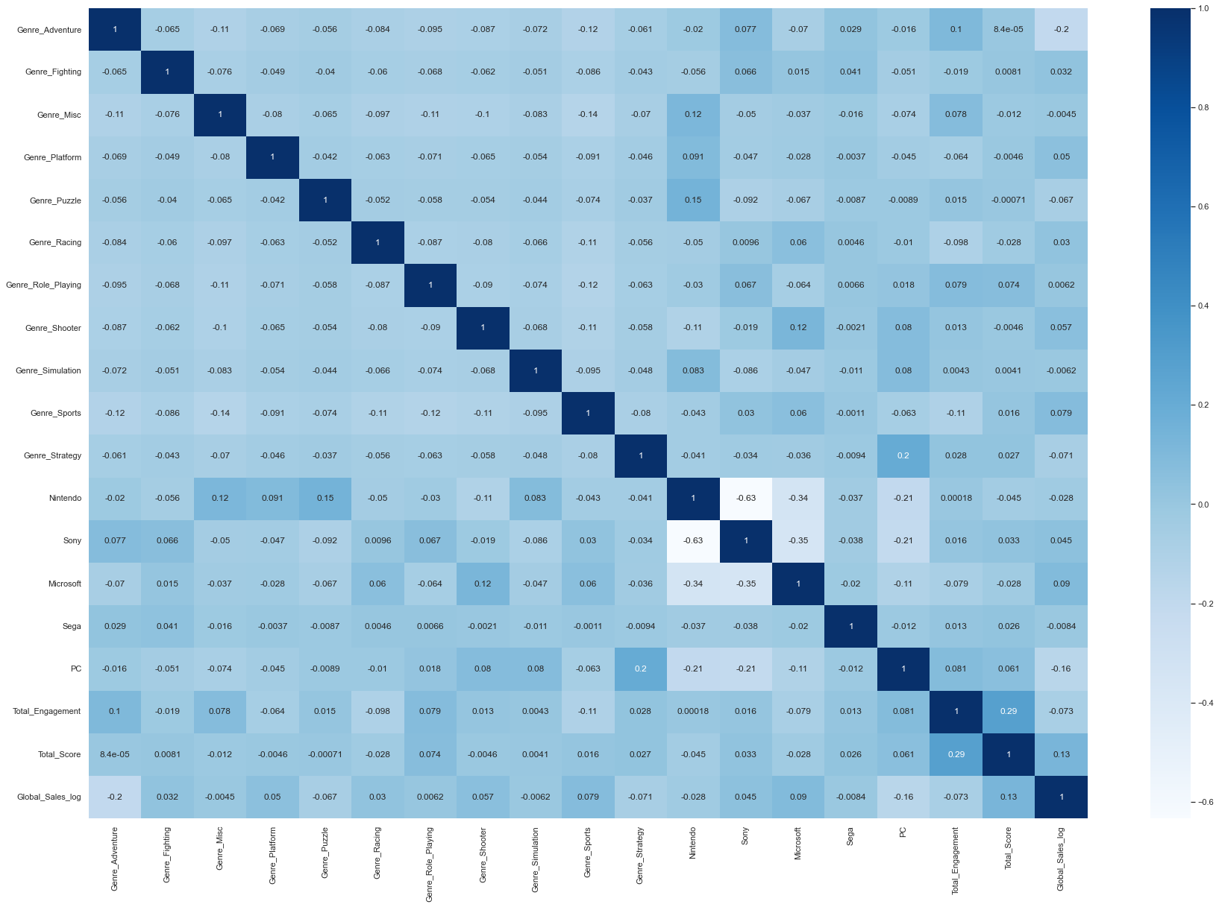
Exploratory Data Analysis
No key features stood out that showed positive correlation with Global Sales.
Further analysis required to identify any positive correlation with Global Sales.

Slide 7
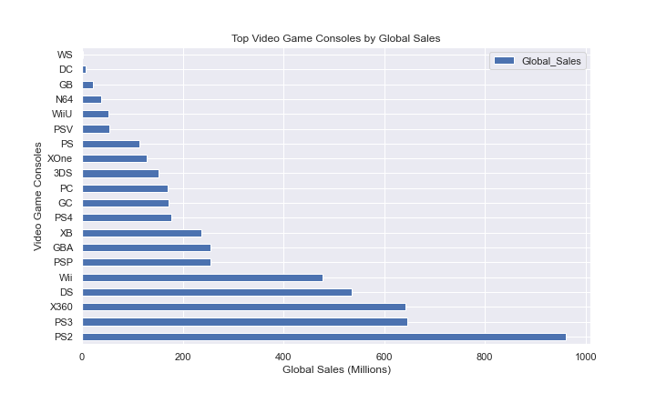
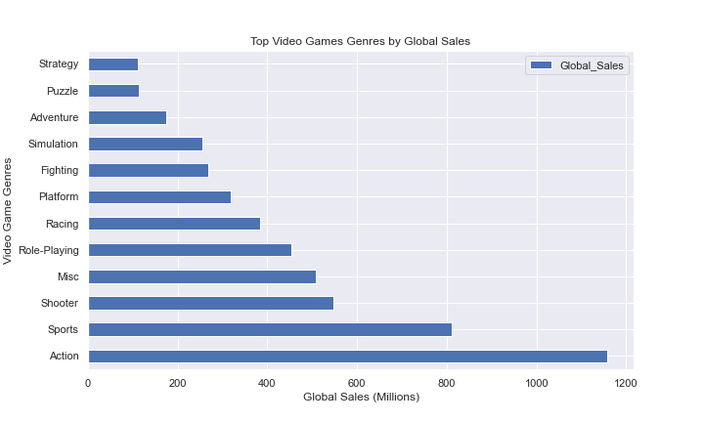
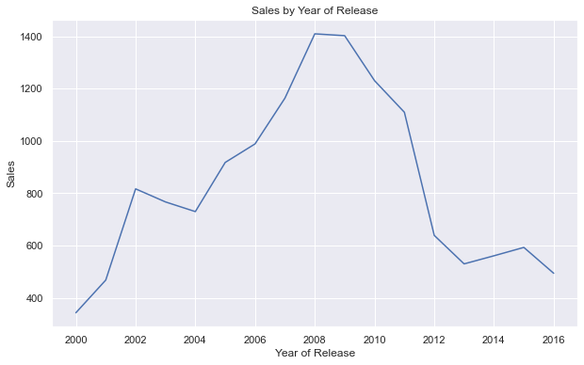
Exploratory Data Analysis
Global Sales for Video Games are highest on the PS2 console while Action games are the highest selling following by Sports and Shooter
Using the platform visualization I modelled two sets of data, individual platforms and then grouping platform together by maker e.g. PS, PS2 and PS3 under Sony and XOne, X360 under Microsoft
Number of games peaked in 2008 and 2009 but had declined since

Slide 8
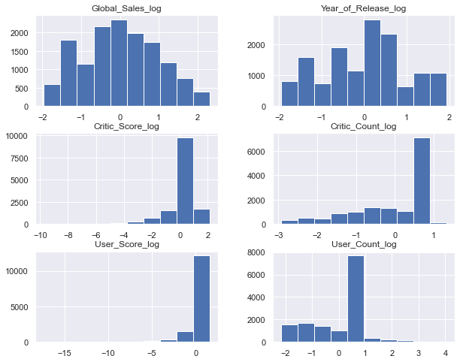
Exploratory Data Analysis
Used mean normalization to standardise the data
All features appeared ok however the critic and user variables are somewhat negatively skewed

Slide 9
Exploratory Data Analysis
Unfortunately no models could provide concrete recommendations
Model / Features | R^2 | Train MSE | Test MSE
Model 1: All Features | 0.28 | 0.73 | 0.76
Model 2: All Features minus Publisher | 0.19 | 0.80 | 0.82
Model 3: Genre, Grouped Platform, Total Engagement, Total Score | 0.12 | 0.88 | 0.90
Polynomial 1st Degree: All features | 0.12 | - | -
Polynomial 2nd Degree: All features | 0.21 | - | -
Polynomial 3rd Degree: All features | -8.02 | - | -

Slide 10
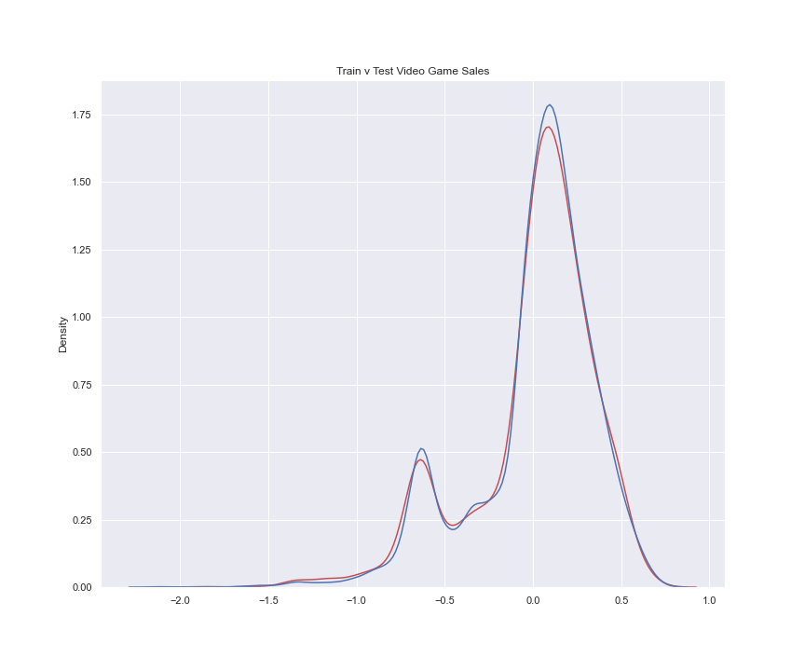
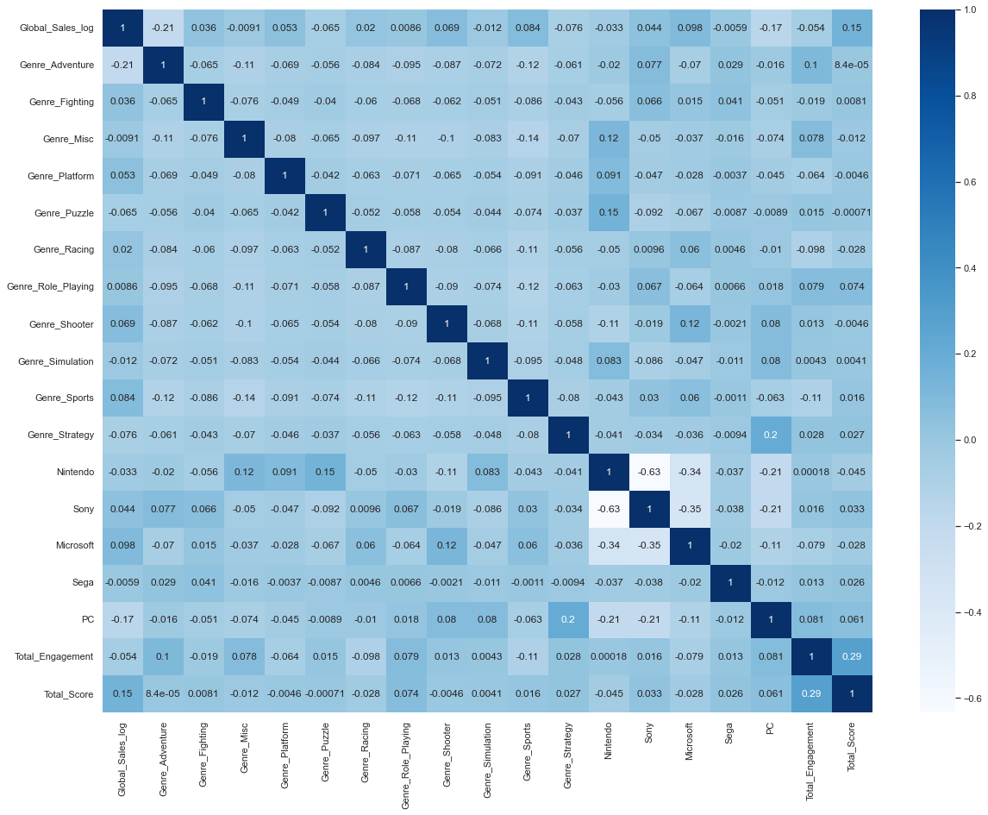
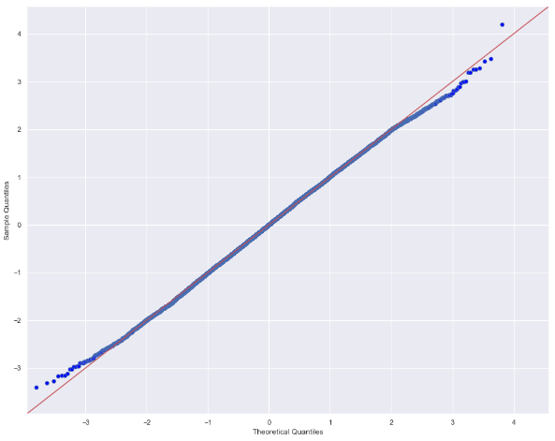
Model 1

Slide 11
Conclusions
While there is highly performing genres, platforms and publishers the Global Sales can’t be accurately predicted using OLS and Polynomial Regression modelling
It is suggested that advanced regression models are used to drive decisions
It is however recommended that insights are used for focus areas such has highly performing genres, engagement and consoles

Slide 12
Thank You!
Email: nathaniel.berryman@gmail.com
GitHub: @natberr
LinkedIn: linkedin.com/in/nathaniel-berryman/

